Slide 1
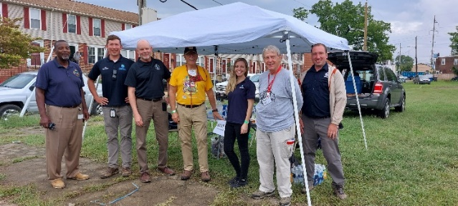
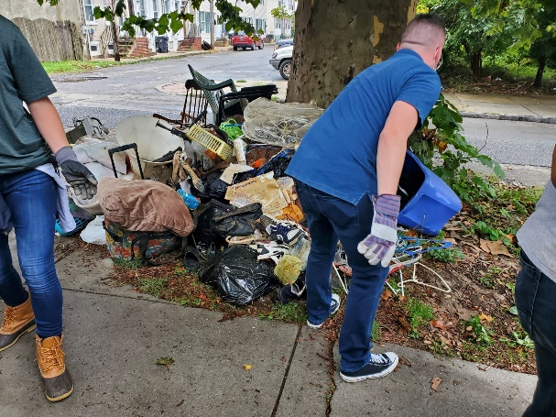
Welcome!
Quarterly Meeting, 25 January 2022
Delaware Volunteer Organization Active in Disaster (DEVOAD)
Agenda
Chair Update
DEVOAD Business
Acceptance of 1 Nov Mtg Minutes
Election of Officers
Bylaws change
Partner Updates
Update on 11th St Bridge Flooding Response
Update on ESBCLTRG
Member Updates
Wrapup

Slide 2
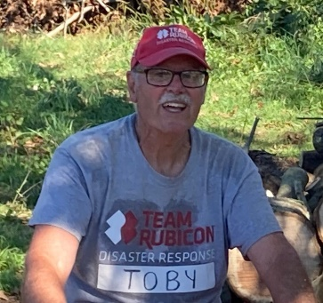
DEVOAD Business
Chairperson Update
DEVOAD Members receive Governor’s Awards
Joint MD-DE Annual Conference 14, 15 March
NVOAD Annual Conference, Baltimore 2-5 May
Changes at DEMA
Plywood Donation and Storage
Financial Review – Treasurer’s Report
Board Member Elections
Chair, Vice Chair, Secretary, Treasurer, Member-At-Large
Vote on Bylaw Change
Add Affiliate Member category

Slide 3
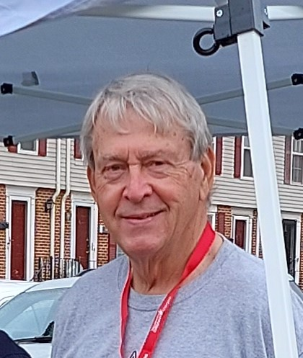
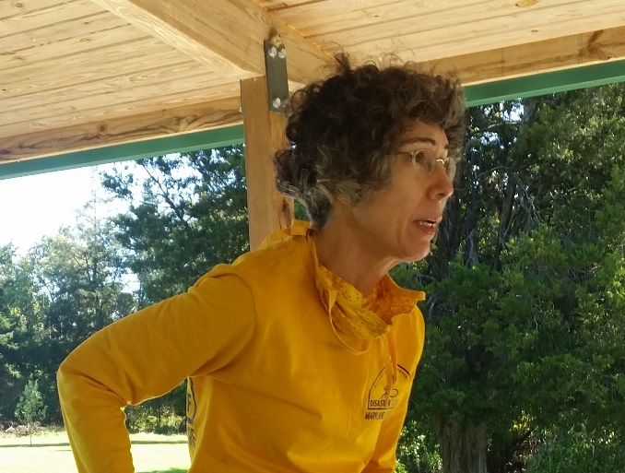
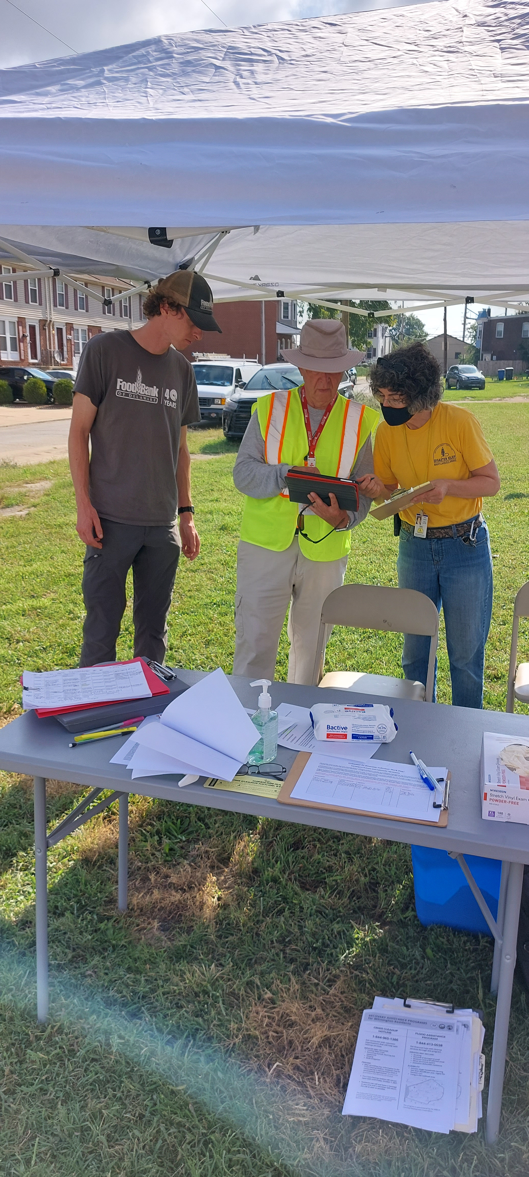
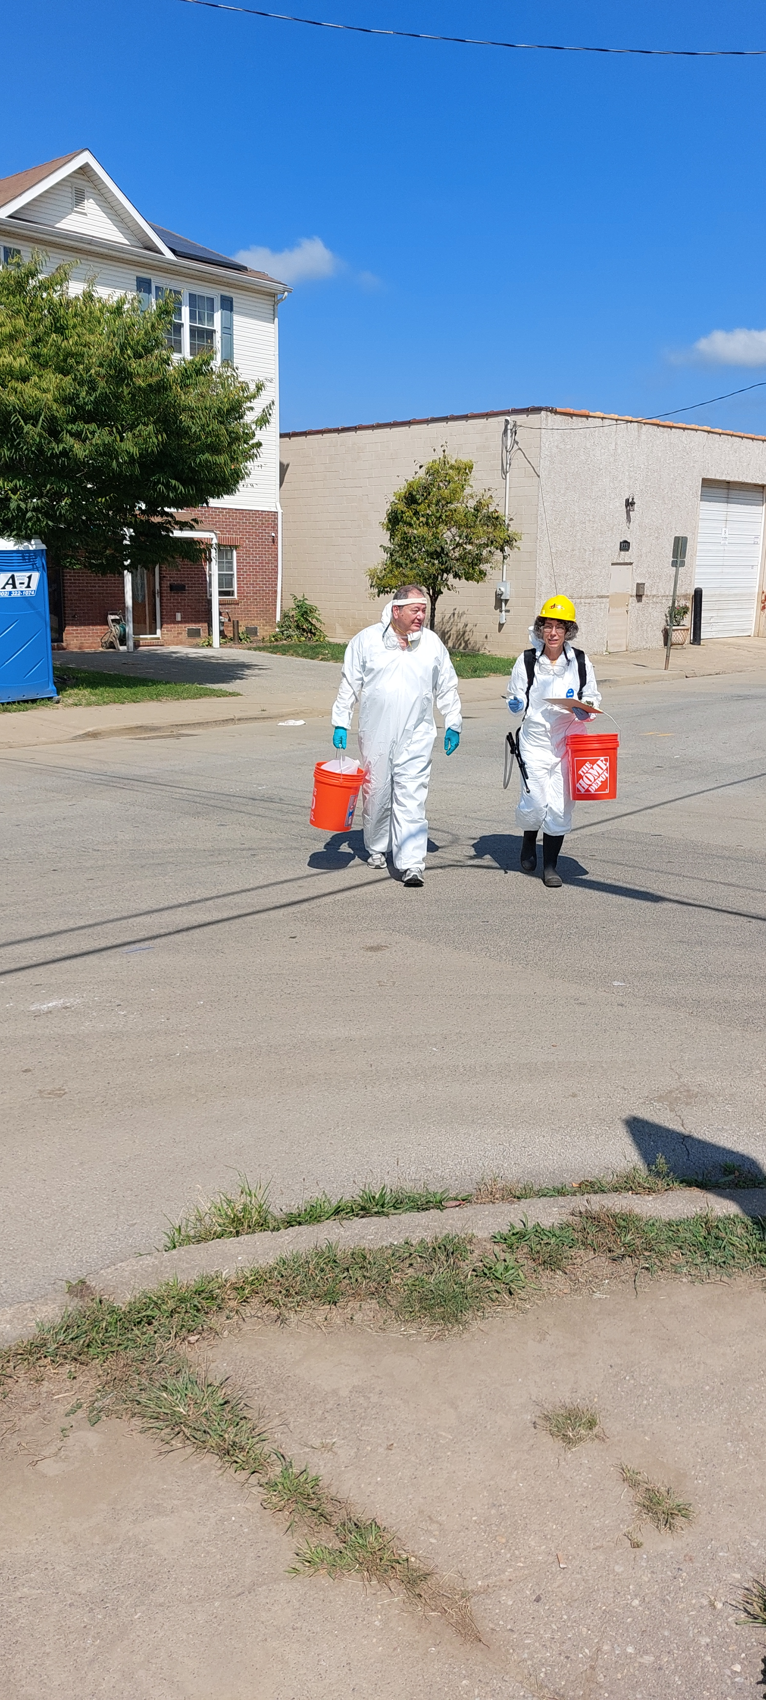
CONGRATULATIONS!!!
2021 Recipients DE Volunteer Governor’s Award
Marty Brett
DEVOAD Vice Chair
Group Award:
Baptist Conventions of MD/DE
and Ellen Udovich

Slide 4
Election of Officers
Position | Candidate | Member Organization
Chair | Ian (Toby) French | Team Rubicon
Vice Chair | Marty Brett | ARRL
Secretary | Chad Robinson | Food Bank of DE
Treasurer | Sharonda Everett | United Way of DE
Member At-Large | Celeste Peart | DE Best

Slide 5
Update to DEVOAD Bylaws
Affiliate Organizations are For-Profit Corporations that have offices in the mid-Atlantic Region and are interested in participating in disaster preparedness and response in Delaware through donations of in-kind equipment, financial aid, and volunteers. Affiliates have voice, but not vote, at DEVOAD meetings. There are no dues but there is an expectation of support during disaster response.
All DEVOAD Members, Partners and Affiliates agree to provide service and support to all disaster victims in need without regard to age, race, ethnicity, national origin, religious affiliation, or sexual orientation.

Slide 6
Partner Updates
DEMA – Erin Norris, DEMA Natural Hazards
FEMA – Hector Ball, Region 3 VAL for Delaware
National VOAD – April Dembeck, State/Territory Support
Wilmington OEM – Willie Patrick, Wilmington Emergency Manager
MD VOAD Report – Rev Phil Huber, Chair (Bruce Morgenstern reporting)

Slide 7
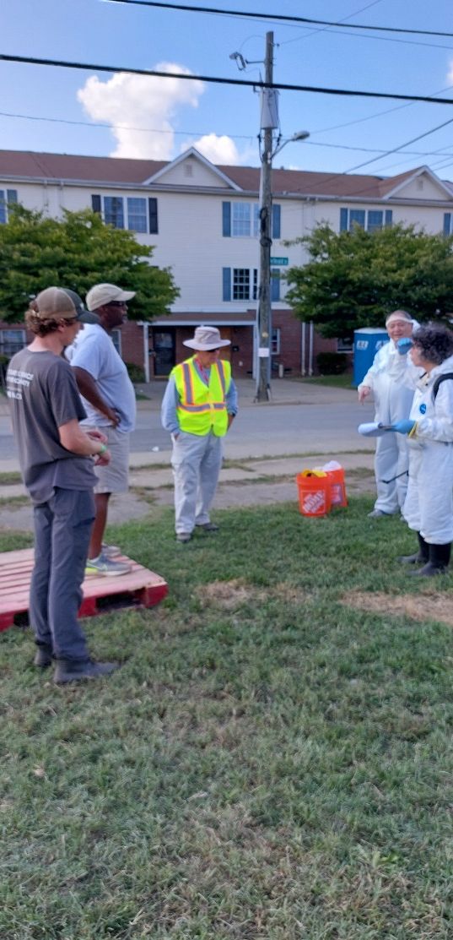
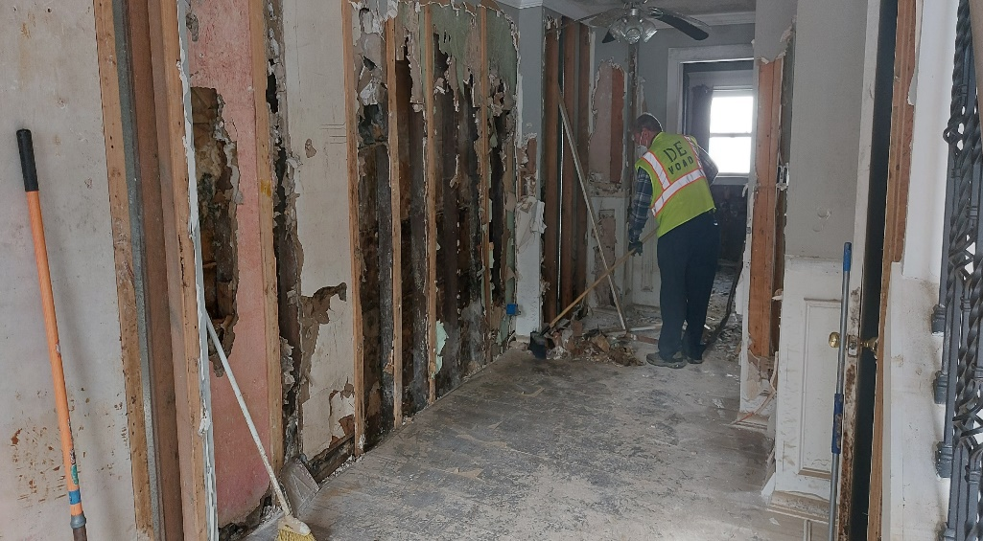
Main Topic: Hurricane Ida Flooding Response
Response Overview - Marty Brett, Vice Chair and Field Lead

Slide 8
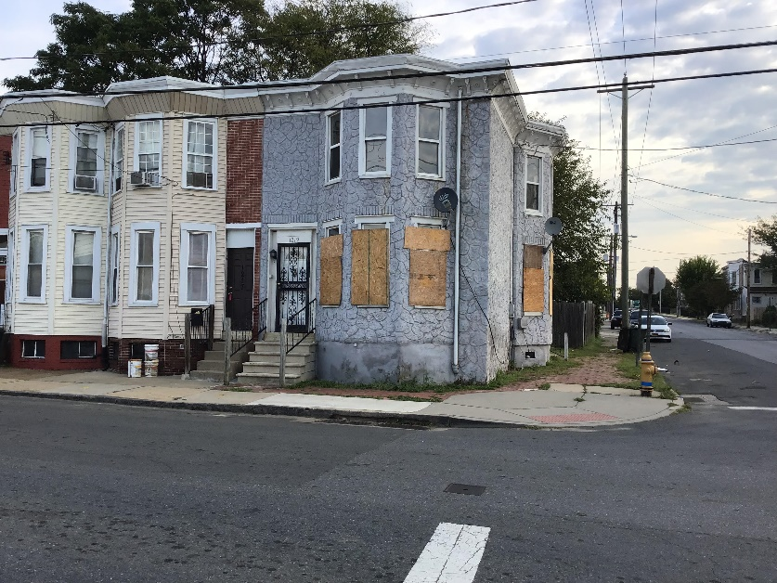
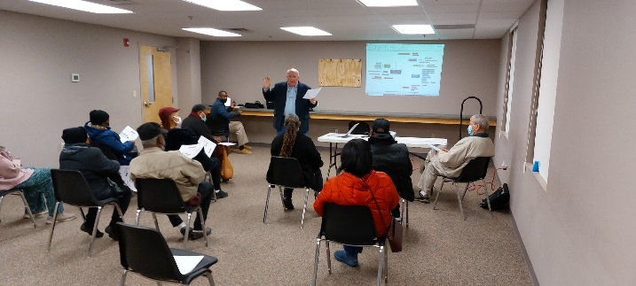
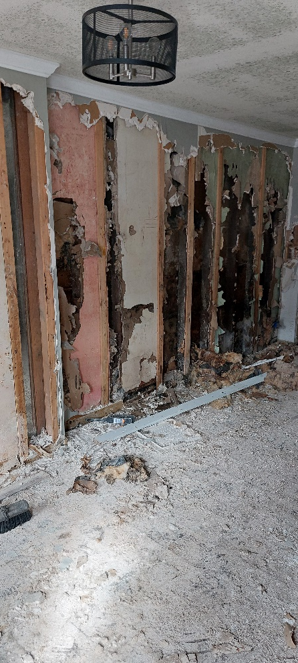
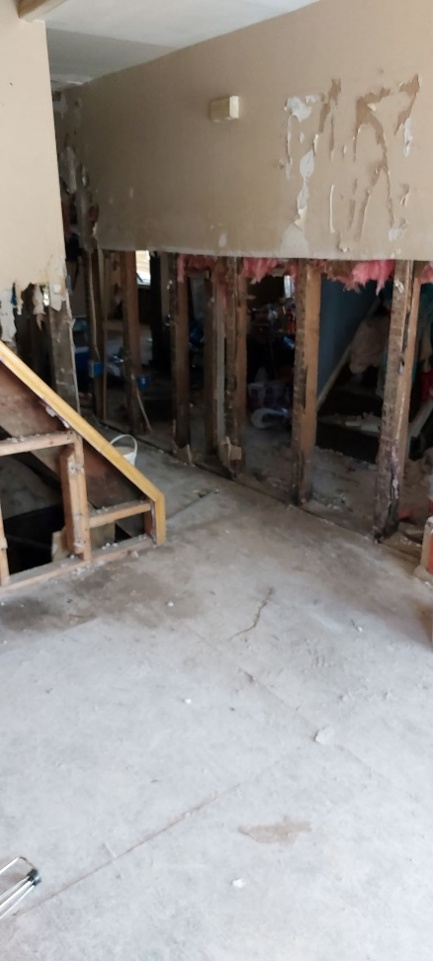
Eleventh Street Bridge Community
Long Term Recovery Group (ESBCLTRG)
Tamika Brooks Collick, Chair

Slide 9
Member Updates
New Member: Brethren Disaster Ministries, Lead: Ed Olkowski
Round Robin

Slide 10
DEVOAD Activity Ahead
Nature’s Message: Disasters can strike at Any Time!
Respond to RFAs as they come in
Participate in and support MDVOAD Annual Conference (Virtual)
Participate in and support National VOAD Annual Conference in Baltimore
Continue with Visibility and Outreach activity
Follow up on inquiries about DEVOAD
Continue to populate and evolve new web site
Support Wilmington LTRG process and meetings

Slide 11
THANK YOU!
Questions?
Suggestions?
Issues?
Pencil in Tuesday 19 April for next meeting
Contact:
delawarevoad@gmail.com
Facebook: Delaware VOAD
Website: devoad.org

