Slide 1
Welcome!
Quarterly Meeting, 2 August 2022
Delaware Volunteer Organizations Active in Disaster (DEVOAD)
Agenda
Storm Season is here! And Hurricane Season started yesterday.
Brief Business Meeting
Long Term Recovery Groups (LTRGs)

Slide 2
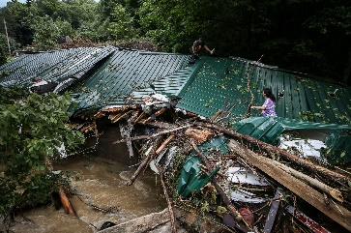
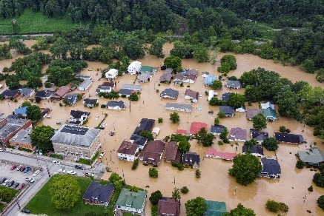
Quarterly Meeting, 2 August 2022
Delaware Volunteer Organizations Active in Disaster (DEVOAD)
Storm Season is here and Hurricane Season started yesterday, 1 August 2022
Storms have already caused damage in our area:
Cecil County, MD wind event, 12 July
Damage to homes in other Maryland counties
Flooding in Buchanan County, VA and West Virginia
And beyond our immediate area:
Severe flooding in eastern Kentucky on 31 July, 38 dead so far
Same storm impacted West Virginia
Flooding in St Louis, MO on 26 July

Slide 3
Quarterly Meeting, 2 August 2022
Delaware Volunteer Organizations Active in Disaster (DEVOAD)
Cecil County, MD wind event, 12 July 2022
Map deleted
Team Rubicon Response
19-25 July
Pictures deleted

Slide 4
FINANCIAL REVIEW - Year To Date
CHECKING INCOME
Dues $ 900.00
Admin for Lowe’s Grant $ 1,050.00
Paypal Transfer $ 365.25 Donations
Expenses:
Check for DEVOAD shirts $ 107.16
Balance $ 11,962.17
SAVINGS (holdings for Eleventh St Bridge Community LTRG)
Startup Grants $ 17,500.00
Longwood Fndtn Grant $ 175,000.00
Balance $ 192,505.17

Slide 5
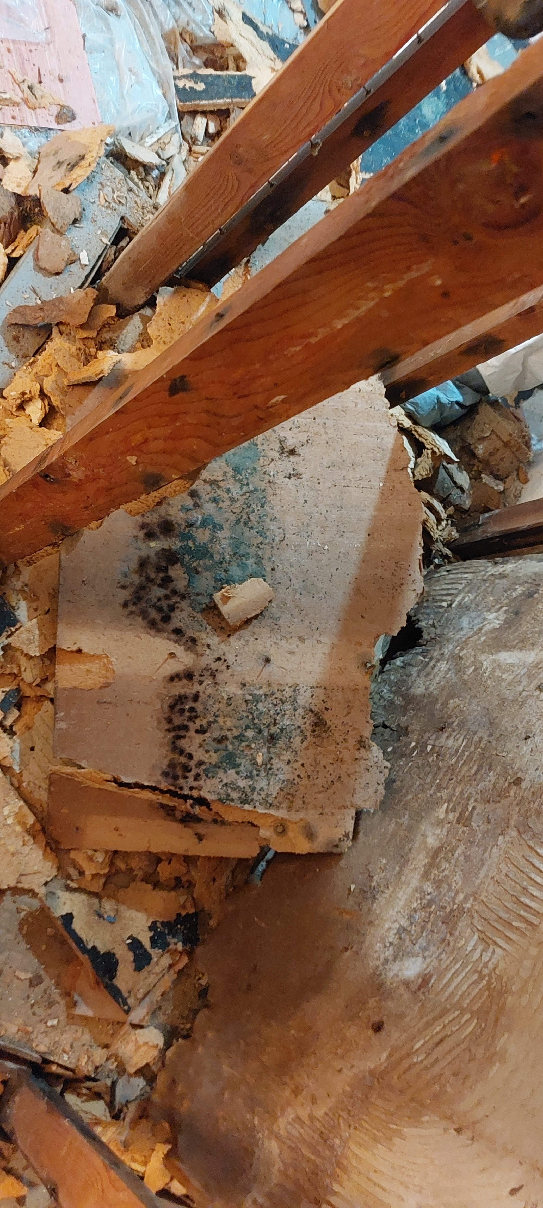
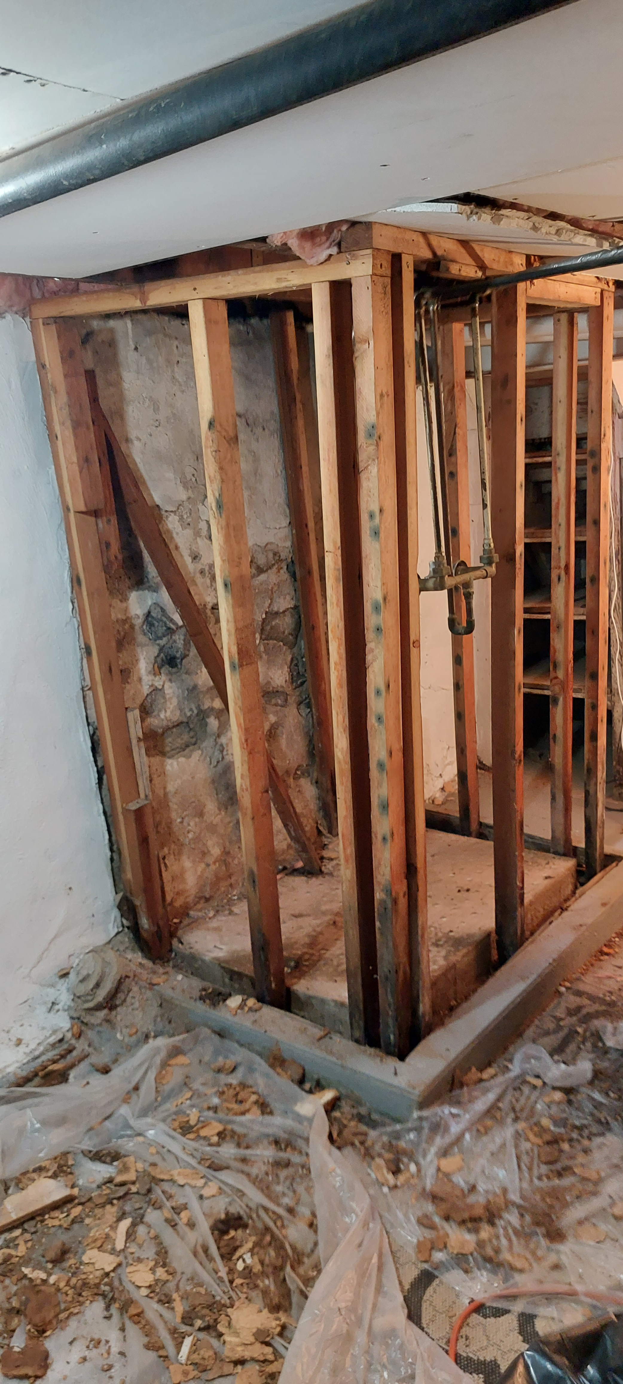
Recent Response Activity
Mold Remediation Activity and Training
- 16 July Vandever Ave – Ellen Udovich
- Training 23 July @ Wilmington EOC – Marty Brett
Mold!

Slide 6
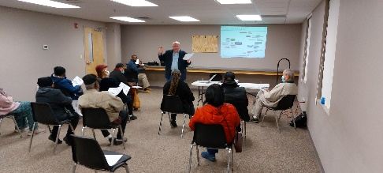
Long Term Recovery Groups (LTRGs)
Rev Phil Huber – Chair, MD VOAD
LTRG Overview
Tamika Collick - Chair, Eleventh Street Bridge Community LTRG (ESBCLTRG), Wilmington
Status Update
NVOAD LTRG Point of Consensus:
“Affirming the critical role of LTRGs in whole community recovery, VOAD members support the formation and operation of local LTRGs by modeling the four Cs of the VOAD movement: cooperation, communication, coordination, and collaboration.”
https://www.nvoad.org/wp-content/uploads/LTRG-POC-Final.pdf

Slide 7
THANK YOU!
Questions?
Suggestions?
Issues?
Next meeting in October, date TBD
Contact:
delawarevoad@gmail.com
Facebook: Delaware VOAD
Website: devoad.org

